Slide 1

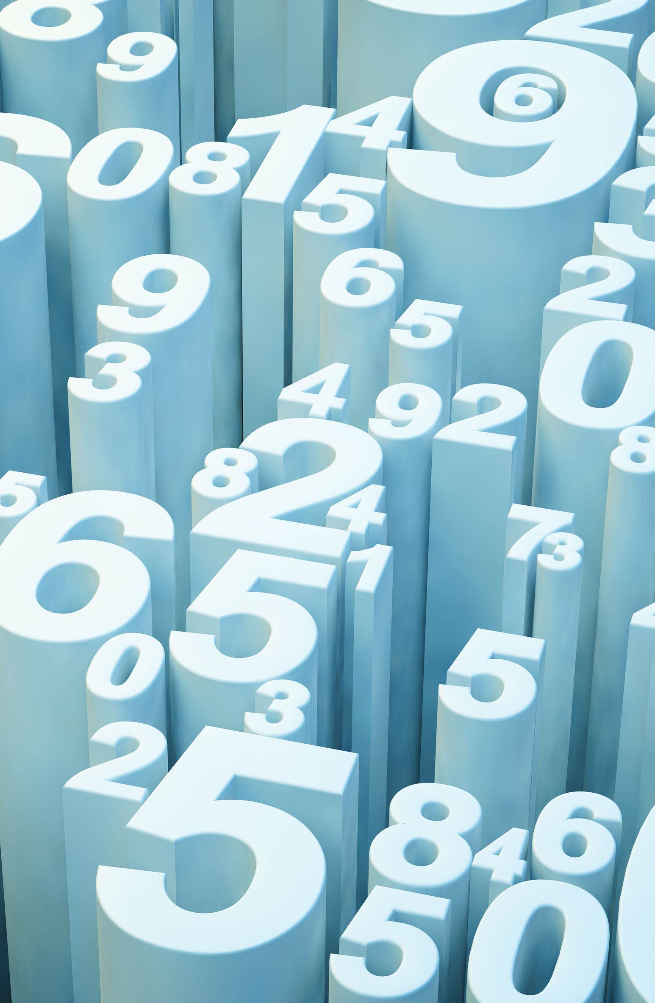
Custom-Object Character Recognition(OCR)
Gaurav Kumar

Slide 2
Overview
Project Objective:
Build a Custom OCR system by combining YOLO and Tesseract.
Extract specific content from lab reports and convert it into an editable CSV format.
Utilize YOLOv3 for object detection, crop detected objects and pass them to Tesseract for text recognition.
Technologies Used:
YOLOv5 (You Only Look Once) for object detection.
Tesseract OCR for text extraction.
Streamlit for web deployment

Slide 3
Features
Object Detection:
Real-time detection using YOLOv5.
Text Extraction:
Text extraction from detected areas using Tesseract.
Data Organization:
Extracted text structured into a CSV file.
User-Friendly Interface:
Built with Streamlit for easy interaction.
Deployment Ready:
Can be deployed on platforms like AWS.

Slide 4
Prerequisites
Software Requirements:
Python 3.7 or higher
Libraries: OpenCV, Pandas, NumPy, labelImg, PyYAML, pytesseract, Streamlit, Tesseract, YOLO Object Detection
Installation Needs:
Tesseract OCR must be installed on the system.
Trained YOLO model in ONNX format.

Slide 5
Installation Steps
Create a virtual environment.
Activate the virtual environment.
Create a requirements.txt file.
Install required libraries.
Install Tesseract OCR.

Slide 6
Data Preparation
Annotating Images:
Used labelImg to annotate images and save them in XML format.
Preprocessing:
Created an XML Data Preprocessing notebook.
Dataset Split:
Split data into train and test sets and created a data.yaml file for training.

Slide 7
Model Training
Training Process:
Train YOLOv5 using the prepared dataset in Google Colab.
Exporting Model:
Exported the trained model in ONNX format for inference.

Slide 8
Scripts
Object Detection Script:
Performs detection using the ONNX model.
Text Extraction Script:
Detects objects and extracts text into a CSV file.

Slide 9
Streamlit App
App Features:
Users can upload images.
Displays annotated results.
Download extracted data as a CSV file.

Slide 10
Usage
Run the Streamlit app with the command:
streamlit run streamlit_app.py
Upload an image file (JPEG or PNG).
View the annotated image and extracted data.
Download the extracted data as a CSV file.

Slide 11
Conclusion
Achievements:
Successfully combined object detection and text extraction.
Created a streamlined process for lab report analysis.
Future Work:
Improve model accuracy.
Enhance user interface and experience.

Slide 12
Thank you!

